Slide 1
What should adaptive therapy optimise?
AI IN MEDICINE · COURSE PROJECT REVIEW
Four reinforcement-learning objectives, one tumour model, and every policy scored on every objective
What we did · How we did it · What we found · What we learned · Draft article
Notes:
This deck reviews the whole project: the question, the methods, the findings from both experiment rounds, and what we learned. A draft research article accompanies it. The one-line version: in this tumour model, most published objectives lead to the same containment policy, coexistence is the outlier and loses, and what the agent can observe matters more than what it optimises.

Slide 2
Every RL paper on adaptive therapy picks its own objective
THE QUESTION
Adaptive therapy
The gap
Treat to contain the tumour, not to eradicate it. Sensitive cells compete with resistant ones, so withholding drug keeps the competitors alive.
Each study optimises one objective inside its own simulator. Survival, dose, coexistence and durability have never been compared on equal terms.
Does the objective change the learned policy, and what does optimising the wrong one cost?
What should adaptive therapy optimise?
2
Notes:
Adaptive therapy (Gatenby 2009) exploits competition: drug-sensitive cells suppress resistant ones, so treating less can delay resistance. Choosing when to treat is a sequential decision problem, and several groups have used RL for it. But each paper picks its own reward and its own simulator, so when two papers report different policies you cannot tell whether the objective, the model or the learner caused the difference. Our project isolates the objective.

Slide 3
Four published rewards, one environment
FOUR OBJECTIVES
Objective | Ported from | What it rewards
R1 Survival + holiday | Gallagher 2023, 2024 | each week alive, plus drug-free weeks
R2 Dose + time | Gluzman 2020 | low cumulative dose and low elapsed time
R3 Coexistence | Giles & Newton 2026 | entropy of the sensitive/resistant mix
R4 Durability | Yao 2024 | a low resistant fraction after a simulated 180-day holiday
Shared by all four: tumour model, observation, actions, PPO settings, step budget, seeds and evaluation code. Only the reward differs.
What should adaptive therapy optimise?
3
Notes:
The ports are interpretations, not literal copies. R2's progression penalty is calibrated so that dying early never pays; the literal Gluzman form would reward early death in a model with no recovery state. R3 is scaled to the same 0.1-per-week size as R1. R4 is scored every week rather than once at the end, because a terminal durability score is either constant or rewards progressing early. All per-step rewards are about 0.1 in size.

Slide 4

One pipeline from tumour model to scorecard
STUDY DESIGN
Value iteration
exact optimum
Tumour model
Four rewards
PPO agents
10 seeds each
Cross-evaluation
Sensitive and resistant cells; weekly dose 0 or 1; stop at progression
R1 to R4, the only part that changes between runs
Every policy scored on every objective and every clinical metric
Heuristics
MTD, AT50, AT90, AT-PSC
585
32
1
PPO agents trained
experiments in two rounds
Python module, no RL library, no GPU
What should adaptive therapy optimise?
4
Notes:
The key design rule is that everything except the reward is shared. That makes the off-diagonal of the score matrix meaningful: if an R1-trained agent scores badly on R3, it is because of the objective, not the simulator or the learner. Round one (E0 to E11d) trained 315 agents; round two (the follow-up experiments) trained 270 more. PPO, value iteration, the environment and all analysis live in one module, src/atrl.py.

Slide 5
Two competing cell populations, one drug
METHODS · THE ENVIRONMENT
Setting | Value
Start | N₀ = 0.75 K, 0.1% resistant
Progression | N ≥ 1.2 N₀
Decision | weekly: dose 0 or 1
Observation | full composition (S, R)
Integrator | RK4, half-day steps
Discount | γ = 0.999 per week
Episode cap | 30 years
Strobl 2021 Lotka–Volterra model
dS/dt = r S (1 − N/K)(1 − 1.5 D)
dR/dt = r R (1 − N/K)
S sensitive, R resistant, N = S + R. Both share one capacity K. A full dose (D = 1) makes the sensitive term negative; resistant cells ignore the drug.
Shown for the proof-of-principle patient: r = 0.027 per day, no cost of resistance, no turnover.
What should adaptive therapy optimise?
5
Notes:
This is the model used by Gallagher's deep-RL papers and Ma 2026, so our numbers are comparable to theirs. General form: dS/dt = rS S (1 − N/K)(1 − dD D) − dT S and dR/dt = rR R (1 − N/K) − dT R, with cost of resistance 1 − rR/rS and turnover dT/rS. The robustness patients vary those two. The full-composition observation is an oracle; later experiments replace it with tumour burden only, which is closer to what a clinician sees through PSA. Gamma 0.999 per week means a horizon of about 19 years, so episodes are effectively undiscounted.

Slide 6
Three kinds of policy, one scorecard
METHODS · POLICIES AND SCORING
Value iteration
PPO agents
Heuristics
Exact policy iteration on a 161 × 241 grid of burden and log resistant fraction. Each objective’s optimum.
Our own vectorised PPO, 2 × 128 actor–critic, 10⁶ steps, 10 seeds. One setting for all objectives.
MTD treats always. AT50/AT90 treat until burden falls to 50%/90%. AT-PSC is tuned on this patient.
score = (G − Gnone) / (GVI − Gnone)
0 = no treatment, 1 = optimum. Agents under 0.7 “did not train”. Policy differences must beat seed noise in a permutation test.
What should adaptive therapy optimise?
6
Notes:
Value iteration uses the same step and reward code as training, with bilinear interpolation on the grid; it converges in 3 to 10 policy-iteration steps. Doubling the grid (follow-up A3) moved no ceiling by more than 0.36%. PPO hyperparameters: 32 parallel environments, 128-step rollouts, 10 epochs, learning rate 3e-4 annealed, clip 0.2, GAE lambda 0.99 (chosen on pilots for all objectives at once), entropy 0.01. G is an objective's discounted return. The permutation test compares between-objective divergence (symmetric KL and greedy-action disagreement on visited states) against within-objective seed-to-seed divergence, Bonferroni corrected.

Slide 7
32 experiments in two rounds
METHODS · EXPERIMENTS
Validate
Core comparison
Robustness
Observation
Round 2
E0 reproduce Gallagher 2023
E2 optimum per objective
E6 coexistence target
E11 burden only
A equal budgets, new patient, finer grid
E3 train 4 × 10 agents
E7 20 held-out patients
E11b + full-state critic
E1 heuristics and headroom
E4 cross-evaluation
E8 ±25% parameters
E11c 8-week memory
B Pareto front, reward shape, switching
E5 policy divergence
E9 monitoring cadence
E11d memory, 3× budget
E10 drug mechanism
C cost × turnover map
E3c–5c cost of resistance
D graded doses
E mutation, partial sensitivity
What should adaptive therapy optimise?
7
Notes:
Round one (E0 to E11d, 315 agents) implements the Phase 2 plan: validate, compare, stress-test, then relax the oracle observation. Round two (270 agents) answers reviewer-style questions: are budgets equal across observation settings (A2), does it hold on a turnover patient (A1) and across a 25-point cost × turnover map (C1), is the VI grid fine enough (A3), and what changes with graded doses, switching costs, mutation and partially sensitive resistant cells.

Slide 8
The environment reproduces the published benchmark
FINDINGS · VALIDATION
451.6 d
662.8 d
< 0.01 d
Continuous therapy to progression. Paper: 450–451 d.
AT50 with daily decisions. Paper: 662 d.
Our RK4 against a high-precision ODE solver.
The plan’s 1% starting resistant fraction reproduced nothing. The authors’ code uses 0.1%, and with it every published number matches.
What should adaptive therapy optimise?
8
Notes:
E0 reproduces Gallagher 2023 Figure 2. The paper quotes AT50 as both 662 and 672 days; we reproduce 662.8 with daily decisions and exactly 672 with a 28-day cadence checked only at decision points, so the 672 is most likely a monthly-cadence number. E1 then sets the bar: maximum tolerated dose progresses at 452 days, AT50 at 673, AT90 at 932, and a tuned AT-PSC rule at 1135 days. The tuned rule turns into full-cycle containment. The value-iteration optimum reaches 2038 days, so there is a lot of room above the heuristics.

Slide 9
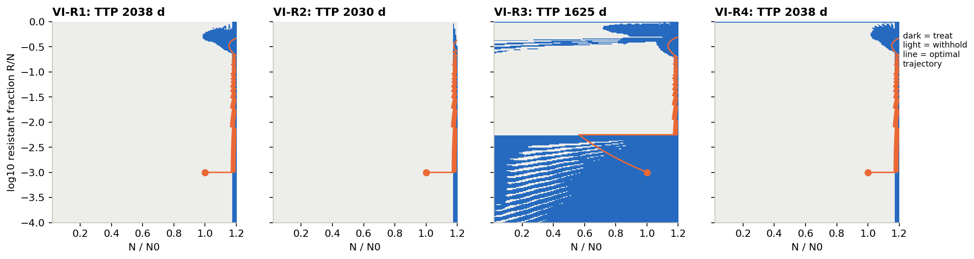
At the optimum, three objectives choose the same policy
FINDINGS · THE OPTIMUM (E2)
R1, R2, R4: containment. Hold the tumour just under 1.2 N₀; treat only when next week would cross it. 2030–2038 d.
R3: treats early to escape its entropy penalty, then contains. Progresses about 400 days sooner, at 1625 d.
What should adaptive therapy optimise?
9
Notes:
Each panel is the optimal treat (blue) or withhold (light) decision over burden N/N0 on the x-axis and log resistant fraction on the y-axis; the orange line is the optimal trajectory from the start state. For R1, R2 and R4 the treat region is a thin strip just below the progression line: let the tumour regrow, and pulse the drug only when the next week would cross 1.2 N0. R3 also treats across a wide band at low resistant fraction, because its reward penalises a nearly pure tumour, so it pushes the resistant fraction up early. The grid value matches simulated returns to within 1%.

Slide 10
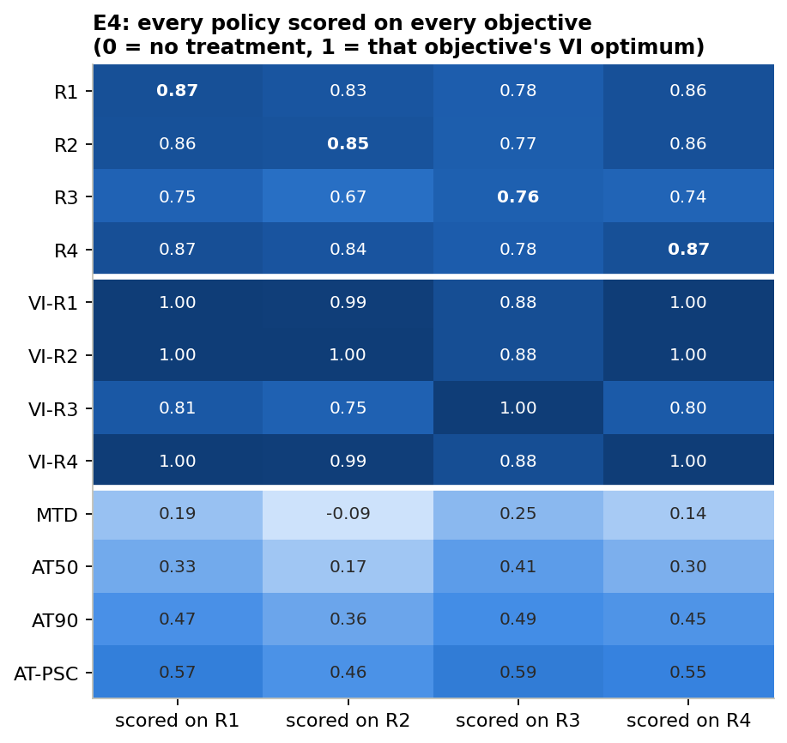
Training on coexistence costs 12–18% everywhere else
FINDINGS · CROSS-EVALUATION (E4)
0.12–0.18
lost on each other objective by R3-trained agents
≤ 0.02
lost among survival, dose and durability
0.78 vs 0.76
Survival-trained agents beat coexistence-trained ones on coexistence itself
What should adaptive therapy optimise?
10
Notes:
Every policy is scored on every objective, normalised so 0 is no treatment and 1 is that objective's optimum. The bold diagonal is each agent on its own objective: 0.85 to 0.87 for R1, R2 and R4, and 0.76 for R3. Read across the R3 row: training on coexistence costs 12 to 18 points on every other objective. The other three cost each other at most 2 points. TTP medians: R1 1744, R2 1726, R3 1494, R4 1751 days; Kruskal–Wallis p = 1e-5, and R1, R2, R4 are not significantly different. The Phase 2 headline hypothesis, that coexistence-training would outlast survival-training, fails with p = 1. It holds in reverse: survival-training is the better way to get coexistence.

Slide 11
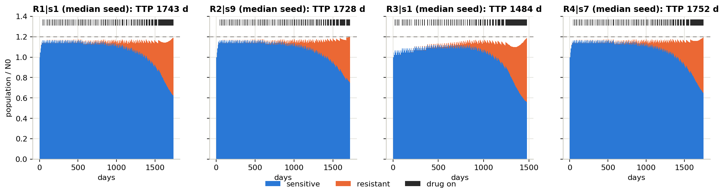
What containment looks like in a trained agent
FINDINGS · TRAINED AGENTS
Weekly pulses hold the tumour under 1.2 N₀. Sensitive cells stay abundant; the resistant clone grows anyway and finally fills the space.
The R3 agent treats from day one, lowering burden early and progressing about 260 days sooner (1484 d vs 1743 d).
What should adaptive therapy optimise?
11
Notes:
Median-seed trajectory for each objective. Blue is the sensitive population, orange the resistant one, and the black ticks along the top are weeks on drug. All four agents learn containment with weekly pulses. In the last year the drug is on almost continuously, because the resistant clone has grown big enough that every week threatens progression. Learned thresholds: R1 1.144, R2 1.149, R3 1.084, R4 1.146 of N0, against 1.174 for the optimum. Agents keep a safety margin below the line; that margin costs about 15% of TTP but, as we will see, makes them robust to model error.

Slide 12
Durability is not a separate objective in this model
FINDING · R1 ≡ R4
Long survival, slow resistant regrowth and a low resistant fraction are all maximised by one thing: keeping sensitive competitors abundant.
R1 and R4 match at the optimum and in trained agents, on all three reference patients and at 25 of 25 points of the cost × turnover map.
What should adaptive therapy optimise?
12
Notes:
This held for both durability definitions we tried: the 180-day regrowth of the resistant population, and the resistant fraction after a 180-day holiday. A heavier durability weight does change the policy, but only through a loophole: the agent learns to stop treating once a week of survival would score negatively, which is giving up early. Closing the loophole with the R2-style progression penalty restores containment. Two follow-ups found the only splits: with graded doses, R1 differs from R4 only because the holiday bonus pays at zero dose alone; and with S to R mutation at 3e-5 per day, the optimum separates the two by a small amount that trained agents cannot detect (p = 0.18).

Slide 13
Learned policies outlast the best heuristic by about 50%
FINDINGS · RL VS OPTIMUM VS HEURISTICS
Time to progression, proof-of-principle patient (days)
Max tolerated dose
452
AT50 (trial rule)
673
AT90
932
AT-PSC, tuned (best heuristic)
1135
PPO, full state (R1)
1744
PPO, burden + critic (R1)
1855
Value-iteration optimum
2038
But the optimum is brittle. With ±25% parameter error its lower-quartile TTP falls to about 110–160 d; agents keep 1680–1730 d.
What should adaptive therapy optimise?
13
Notes:
PPO agents reach about 85% of their own optimum and beat every tuned heuristic. The exact optimum rides right at the progression line, so when the true patient differs from the planning model it often crosses the line early. The agents' learned margin (threshold about 1.145 instead of 1.174) protects them. Another robustness result from E9: every learned policy fails badly if it is monitored less often than it was trained; weekly-trained agents evaluated monthly progress at 83 days. Monthly-trained agents survive every cadence. This replicates Gallagher's asymmetry. Values are medians over 10 seeds.

Slide 14
Coexistence comes last under every stress test
FINDINGS · ROBUSTNESS
Stress test | Coexistence (R3)
20 held-out virtual patients (E7) | last for 20 of 20
Parameters off by ±15–25% (E8) | still last
Log-kill and cytostatic drug models (E10) | still last
Cost of resistance 0.42 (E3c) | costs 0.13–0.17 elsewhere
Turnover 0.04 (A1) | costs 0.17 elsewhere
25-patient cost × turnover map (C1) | 20–23% shorter survival
Progression line at 1.1–1.3 N₀ (B4) | 14–27% shorter survival
Not robust, so not claimed: the order among R1, R2 and R4.
What should adaptive therapy optimise?
14
Notes:
Why does coexistence fail so consistently? In any patient who eventually progresses, the resistant population grows under every policy, so a two-population mix cannot be held. The entropy reward reduces to treat early, then contain. Changing the coexistence target from 5% to 50% resistant changed nothing (E6). A smooth entropy reward was worse, not better (B2), and making resistant cells partly drug-sensitive did not rescue it (E2). The optimum holds a target exactly only in patients above Strobl's controllability bound, who never progress anyway. Also robust: weekly-trained agents monitored monthly progress at 83 days, so monitoring must match training.

Slide 15
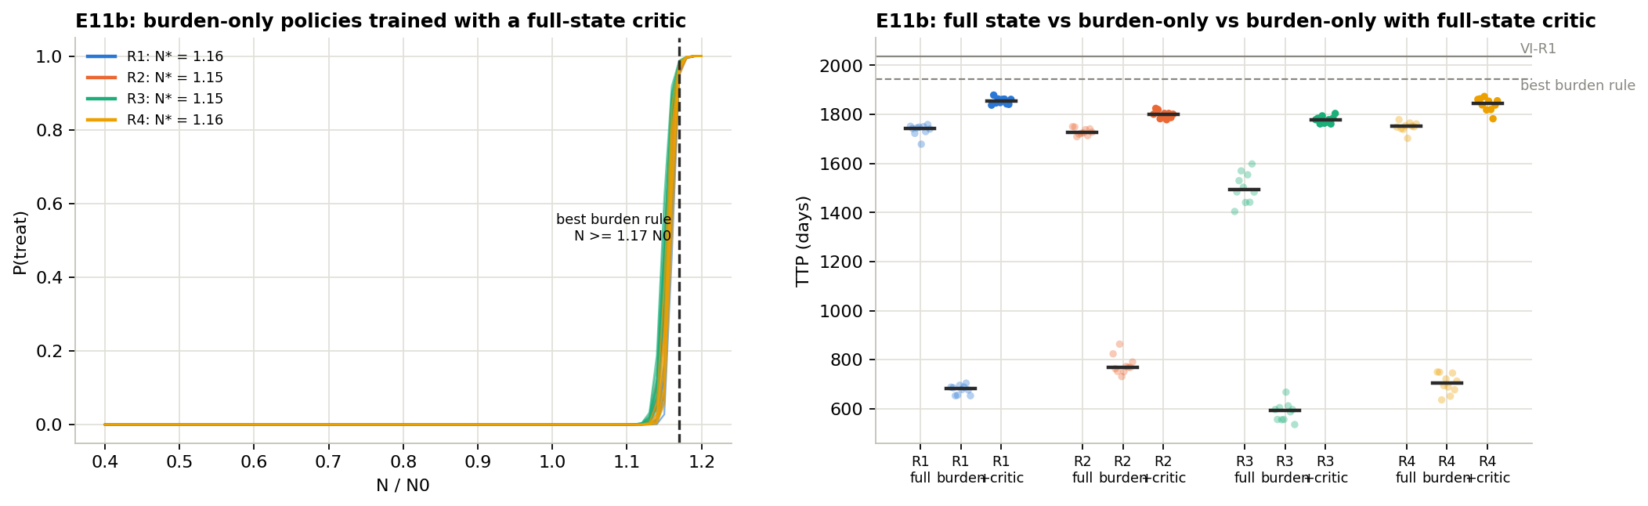
Burden-only agents fail until the critic sees more
FINDINGS · REALISTIC OBSERVATION (E11, E11B)
Burden only: 0.21–0.37 of the optimum, about 700 d. Yet the rule “treat if N ≥ 1.17 N₀” reaches 0.96.
Full-state critic in training only: all 40 train, and every objective beats the full-state agents.
What should adaptive therapy optimise?
15
Notes:
A clinician sees a burden marker such as PSA, not the sensitive/resistant composition. When we gave the agent only N/N0, PPO failed for every objective, learning to treat far too early (at 0.65 to 0.85 N0). That is not an information limit, since a one-line rule on the same input nearly matches the optimum. The diagnosis is critic aliasing: a value function that sees only burden averages over very different futures. The fix is an asymmetric actor–critic: the deployed policy still sees only burden, but the critic sees the full state during training. Every policy then becomes one sharp threshold at about 1.15 N0, and TTP rises to 1779 to 1855 days, above the full-state agents.

Slide 16
What the agent sees matters more than what it optimises
FINDINGS · OBSERVATION VS OBJECTIVE
Actor sees | Score | R1–R3 gap | Wrong-obj. cost
Full composition (E4) | 0.76–0.87 | 250 d | 0.18
Burden only (E11) | 0.21–0.37 | not trained | not tested
Burden + full critic (E11b) | 0.80–0.92 | 76 d | 0.035
8-week burden chart (E11c) | 0.71–0.86 | 220 d | 0.105
Chart, 3× budget (E11d) | 0.80–0.92 | 235 d | 0.133
Equal 3M-step budget (A2): burden + critic 0.97 > full state 0.94 > memory 0.92 of the optimum.
Most of the objective effect depends on composition information a clinician does not have.
What should adaptive therapy optimise?
16
Notes:
Score is each agent on its own objective as a fraction of the optimum. The R1–R3 gap is the difference in median TTP between survival-trained and coexistence-trained agents, and wrong-objective cost is the largest off-diagonal loss in the score matrix. With burden only plus a full-state critic, the objectives nearly collapse together: the gap shrinks from 250 to 76 days and the cost from 0.18 to 0.035. Giving the actor an 8-week chart brings part of the effect back, but R2- and R3-trained memory agents score no better on their own objectives than R1-trained agents, and seed-to-seed noise is about four times higher even at three times the budget. So the memory effect is a learning artefact, not better service of those objectives.

Slide 17
Graded doses, switching and mutation
FINDINGS · ROUND 2 FOLLOW-UPS
Graded doses (D1–D3)
Fewer switches (B3, D4)
A half dose adds 70–168 days. R1 and R4 split, but only because R1’s holiday bonus pays at zero dose alone.
Optima switch dose on 54% of weeks. Halving that costs 3–8%; at 9 switches a year the optimum still beats AT-PSC by 55%.
Mutation, S → R (E1)
Pareto view (B1)
The first split of durability from survival at the optimum, but small, and invisible to trained agents (p = 0.18).
Good policies all run at about 72% dose intensity. R2’s memory agents trade time for less drug and sit on the frontier.
What should adaptive therapy optimise?
17
Notes:
Graded doses: with doses {0, 0.5, 1}, the R4 optimum rises from 2038 to 2143 days. R1 never uses the half dose because Gallagher's holiday bonus is all-or-nothing; making the bonus proportional to the drug withheld reproduces the R4 optimum exactly, so R1 equals R4 again. More dose levels help the planner (2205 days with 5 levels) but hurt PPO; a single growth-halting dose of 2/3 captures most of the gain. Switching: a switching penalty gives clinically legible schedules cheaply. Mutation: at 3e-5 per day, R4's optimum leaves a post-holiday resistant fraction of 0.444 vs 0.490 for R1, at 6 days less TTP. Pareto: R2's apparent failure in the memory setting is a trade-off of about 285 days for 4 points of dose intensity.

Slide 18
Four lessons about adaptive therapy
WHAT WE LEARNED · THE PROBLEM
1
The objective matters less than expected
2
The observation matters more
Survival, dose and durability converge on containment. Only coexistence differs, and it loses.
Hide the composition from the policy and the four objectives nearly merge.
3
Learning is the bottleneck
4
A margin buys robustness
A one-line burden rule beat naive PPO. A full-state critic during training fixed it.
The exact optimum breaks under model error; agents keep a margin. Monitor as often as you trained.
What should adaptive therapy optimise?
18
Notes:
One: in Lotka–Volterra competition the sensitive population is the only lever on the resistant one, so every objective that values time or low resistance ends up maximising sensitive cells under the burden cap, which is containment. Coexistence aims at the wrong quantity: a 50:50 mix is a state of advanced resistance. Two: what the policy can see decides how much the objective can change it; clinicians see burden, not composition. Three: the information was there; the learning signal was not. Four: the agents' threshold sits about 0.03 N0 below the optimum's, costing about 15% of TTP in the nominal model but protecting against misspecification.

Slide 19
Five lessons about RL for medicine
WHAT WE LEARNED · THE METHOD
Rewards hide loopholes
The literal dose reward pays for early death; a heavy durability weight pays for giving up. Check the optimum first.
Score off the diagonal
Scoring every policy on every objective is what reveals the cost of the wrong one.
Benchmark against an exact optimum
A ceiling and tuned heuristics turn “the agent learned” into “85% of optimal, 50% above the best rule”.
Compare against seed noise
Ten seeds and permutation tests separate real policy differences from luck.
Reproduce before you extend
One wrong starting parameter, 1% instead of 0.1% resistant, broke every published number.
What should adaptive therapy optimise?
19
Notes:
These are the lessons we would carry to the next project. Reward ports need a sanity check of what the optimum does with them: Gluzman's dose-plus-time objective, ported literally into a model without a recovery state, is optimised by never treating and progressing at day 41. Engineering lessons too: training ran as a resumable launcher with cached checkpoints, so two runs killed by low memory lost nothing; and every extension of the engine was checked to be bit-identical to the original before any new result was trusted.

Slide 20
What this study cannot claim
LIMITATIONS
In silico, one model class
Two well-mixed populations; no space, pharmacokinetics or plasticity.
Few full-matrix patients
Three reference patients, plus optimum-only maps over 25 more.
Oracle observation
The main comparison lets the agent see composition, which clinicians cannot.
Ports are interpretations
R2’s penalty, R3’s scaling and R4’s weekly form are our choices.
No clinical claim
Adaptive therapy itself is not clinically established (Mistry 2021).
What should adaptive therapy optimise?
20
Notes:
Two more caveats worth naming if asked. The value-iteration ceiling is a discretised optimum, so an agent can in principle score slightly above 1; doubling the grid moved ceilings by under 0.4%. And the fixed training budget under-trains long episodes: on the cost-0.42 patient half the R3 seeds fell below the 0.7 rule, and daily-cadence agents saw seven times fewer simulated days. The equal-budget rerun (A2) showed the main orderings are stable at three times the budget. We also used a single learning algorithm, PPO.

Slide 21

Next experiments, and the article
WHAT COMES NEXT
Noisy or delayed readings
PPO on doses {0, 2/3, 1}
Observation is our strongest lever; test it with realistic measurements.
The growth-halting dose gave the planner most of its gain. Can agents learn it?
Previous dose in the input
A toxicity objective
Let PPO learn switching costs that we so far solved only by value iteration.
The likeliest route to a durability goal that truly conflicts with survival.
Draft research article: What should adaptive therapy optimise?
What should adaptive therapy optimise?
21
Notes:
Noisy or delayed burden readings need new observation plumbing in the environment, but they are now the most relevant gap, because the follow-up round made observation the strongest lever in the study. The {0, 2/3, 1} dose set was solved only by value iteration; 2/3 is the dose that exactly halts sensitive growth. The draft article contains the full methods, results with figures, discussion and references.

Slide 22
Containment wins, and what the clinician can see decides how much the objective matters.
IN ONE SENTENCE
Thank you · Questions
Notes:
Summary for questions: survival, dose and durability objectives all lead to containment in this model; coexistence is the outlier and costs 12 to 18 percent everywhere else; durability equals survival; learned agents beat tuned heuristics by about 50 percent; and once the policy sees only what a clinician sees, the objectives nearly merge, provided the critic gets the full state during training.

